Slide 1
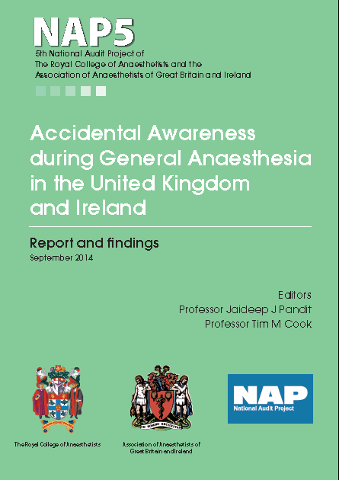
Recommendations

Slide 2
Patient experience

Slide 3
NAP5 pathway
See more at
http://www.nationalauditprojects.org.uk/NAP5-Anaesthetia-Awareness-Pathway

Slide 4
NAP5 pathway

Slide 5
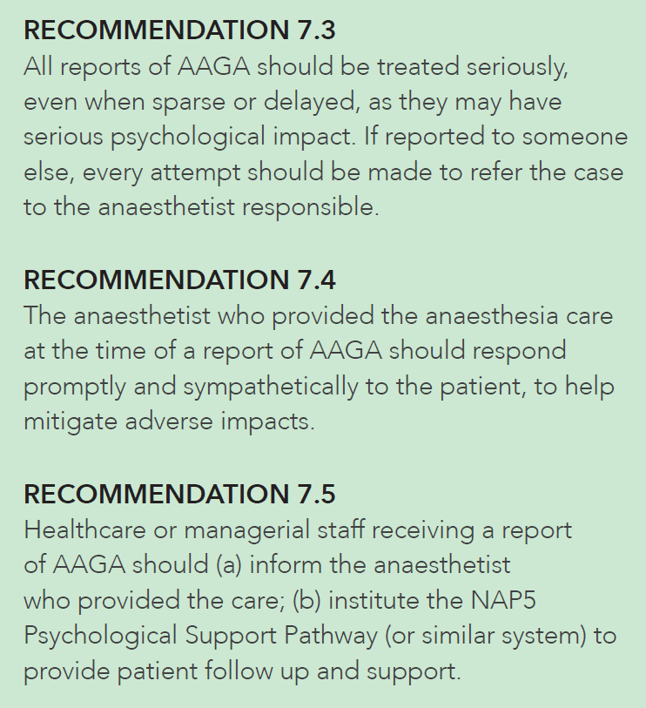
Patient experience

Slide 6
Induction

Slide 7
Induction

Slide 8
Induction

Slide 9
Induction - ‘Mind the gap’ checklist

Slide 10
Induction

Slide 11
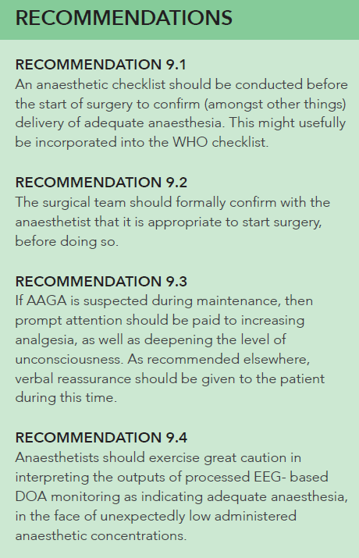
Maintenance

Slide 12
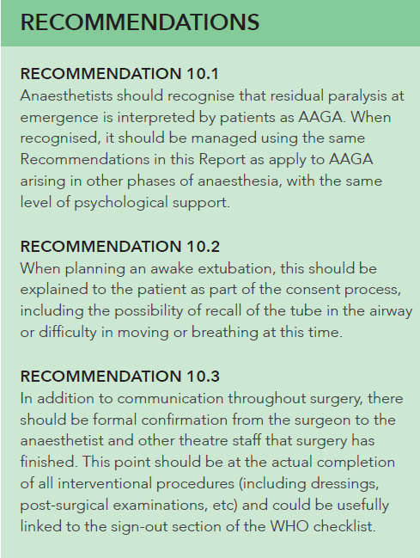
Emergence

Slide 13
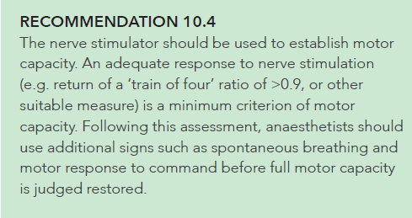
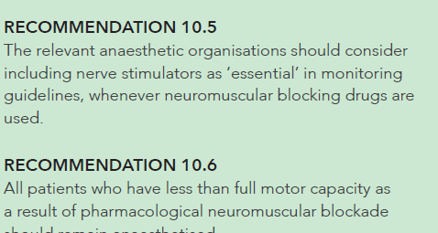
Emergence

Slide 14
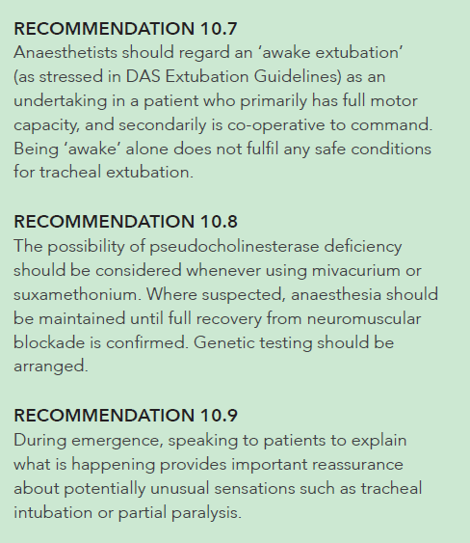
Emergence

Slide 15
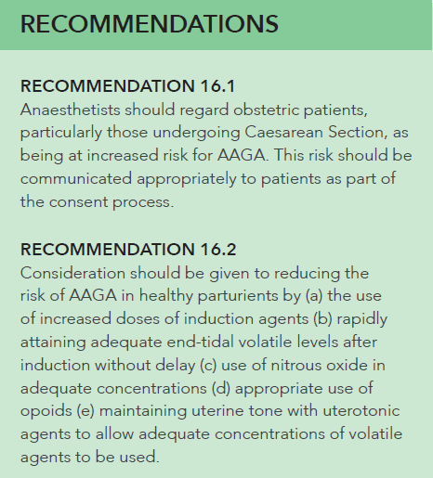
Obstetrics

Slide 16
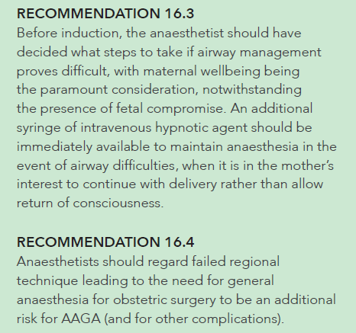
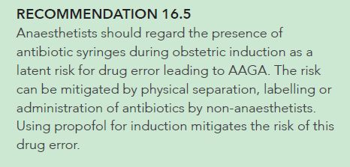
Obstetrics

Slide 17
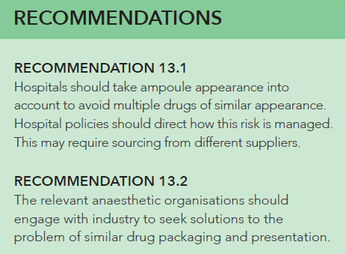
Drug errors – awake paralysis

Slide 18
Reports of AAGA after sedation
Notes:
What should we do about our findings? Recommendations are based on the premise that we all need time to process information and to come to terms with what is an unfamiliar experience. This requires written information reinforced by verbal explanation separated by a period of time for reflection. The explanation should be realistic and not raise expectations that cannot be fulfilled.

Slide 19
 | What will this feel like? | What will I remember? | What’s the risk related to the sedation drugs?
Not sedated: awake | I am awake, possibly anxious. There may be mild discomfort (depending on what I am having done) | Everything | Nearly zero
Minimal sedation | I am awake and calm. There may be mild or brief discomfort. | Probably everything | Very low
Moderate sedation | I am sleepy and calm but remain in control. I may feel mild discomfort. | I might remember some things | Low
Deep sedation | I am asleep, I will not be in control | Probably very little | Higher risk:My breathing may slow when I am asleep –and I may need help to breathe
Anaesthesia | I am deeply asleep and unable to respond. | Very unlikely to remember anything | Higher risk . My breathing may slow or stop and my BP and HR rate may fall. I will need a specialist doctor to look after me
Notes:
Here is a precis of a patient centred explanation. We have suggested a slightly more detailed version of this explanatory table for incorporation into patient literature. A copy is in NAP5 and in your handout.

Slide 20
TIVA

Slide 21
TIVA

Slide 22
NMB
Notes:
12 recommendations relating to NMBs

Slide 23
Notes:
Conceptually, unopposed global neuromuscular blockade is an intervention with capacity to cause great psychological harm, unless it is counteracted by general anaesthesia (as evident in syringe swap reports)
NAP5 contains reports of paralysis at induction, on transfer into theatre, during surgery, during transfer from theatre, and during recovery.
A disruption of the balance can occur at any time during anaesthesia.

Slide 24
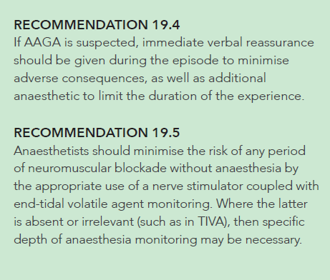
NMB
Notes:
12 recommendations relating to NMBs

Slide 25
DOA

Slide 26
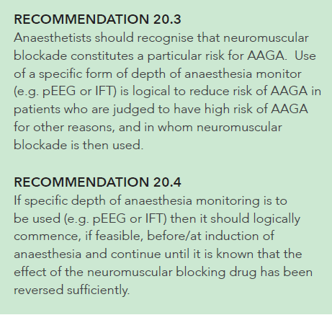
DOA

Slide 27
HF

Slide 28
Medicolegal

Slide 29
Medicolegal

Slide 30
Consent

Slide 31
Consent

Slide 32
Consent

Slide 33
The end

